Slide 1

Creating databases and tables.
DATA ANALYTICS | IRONHACK

Slide 2

IRONHACK BOOTCAMP
CREATING DATABASES
A MySQL database is basically a collection of tables.
A database can be created with the command: CREATE DATABASE name: Ex:
CREATE DATABASE IF NOT EXISTS books;

Slide 3
IRONHACK BOOTCAMP
COLLATION AND CHARACTER SET
Any new database needs to be defined using a:
Character set: which are the allowed characters
Collation: the combinations rules of the characters
The most common character set is: utf8mb4, for which the best collation is: utf8mb4_0900_ai_ci;
CHARACTER SET utf8mb4 COLLATE utf8mb4_0900_ai_ci
Read here for more

Slide 4
IRONHACK BOOTCAMP
CREATING TABLES
The syntax to create a table is:
CREATE TABLE [ IF NO EXISTS ] table_name (
colname1 type [options],
colname2 type [options],
colname3 type [options],
….
);
Where [IF NOT EXISTS] is optional and [options] can be any of:
AUTO_INCREMENT
PRIMARY KEY
Notes:
Adding Alter Table Commands
Adding Create Table from Select statement
Alter Droping table and dropping Database

Slide 5
IRONHACK BOOTCAMP
Alter TABLE (TODO)
Notes:
Adding Alter Table Commands
Adding Create Table from Select statement
Alter Droping table and dropping Database

Slide 6
IRONHACK BOOTCAMP
DROP TABLE and COLUMN, DATABASE (TODO)
Notes:
Adding Alter Table Commands
Adding Create Table from Select statement
Alter Droping table and dropping Database

Slide 7
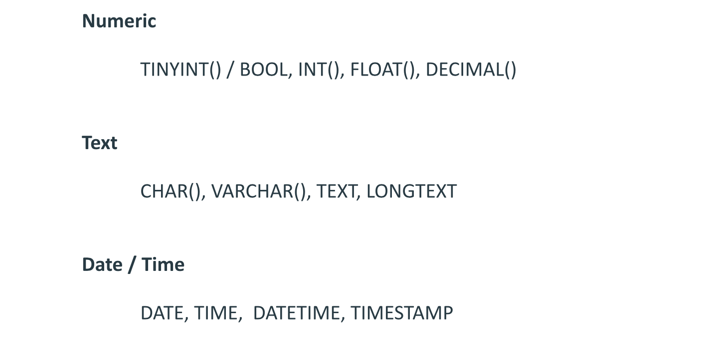
IRONHACK BOOTCAMP
MAIN DATA TYPES
Full data types

Slide 8
IRONHACK BOOTCAMP
LINKING TABLES: PRIMARY AND FOREIGN KEY
PRIMARY KEY:
is a unique identifier for every row of in a table
it can consists of a single or multiple columns of the table
EVERY TABLE must have a PRIMARY KEY
FOREIGN KEY:
is a key column to link two tables together
Is the common column of another table
It serves to enforce data consistency, as you can add rows to the child table if they are not defined in the parent table

Slide 9
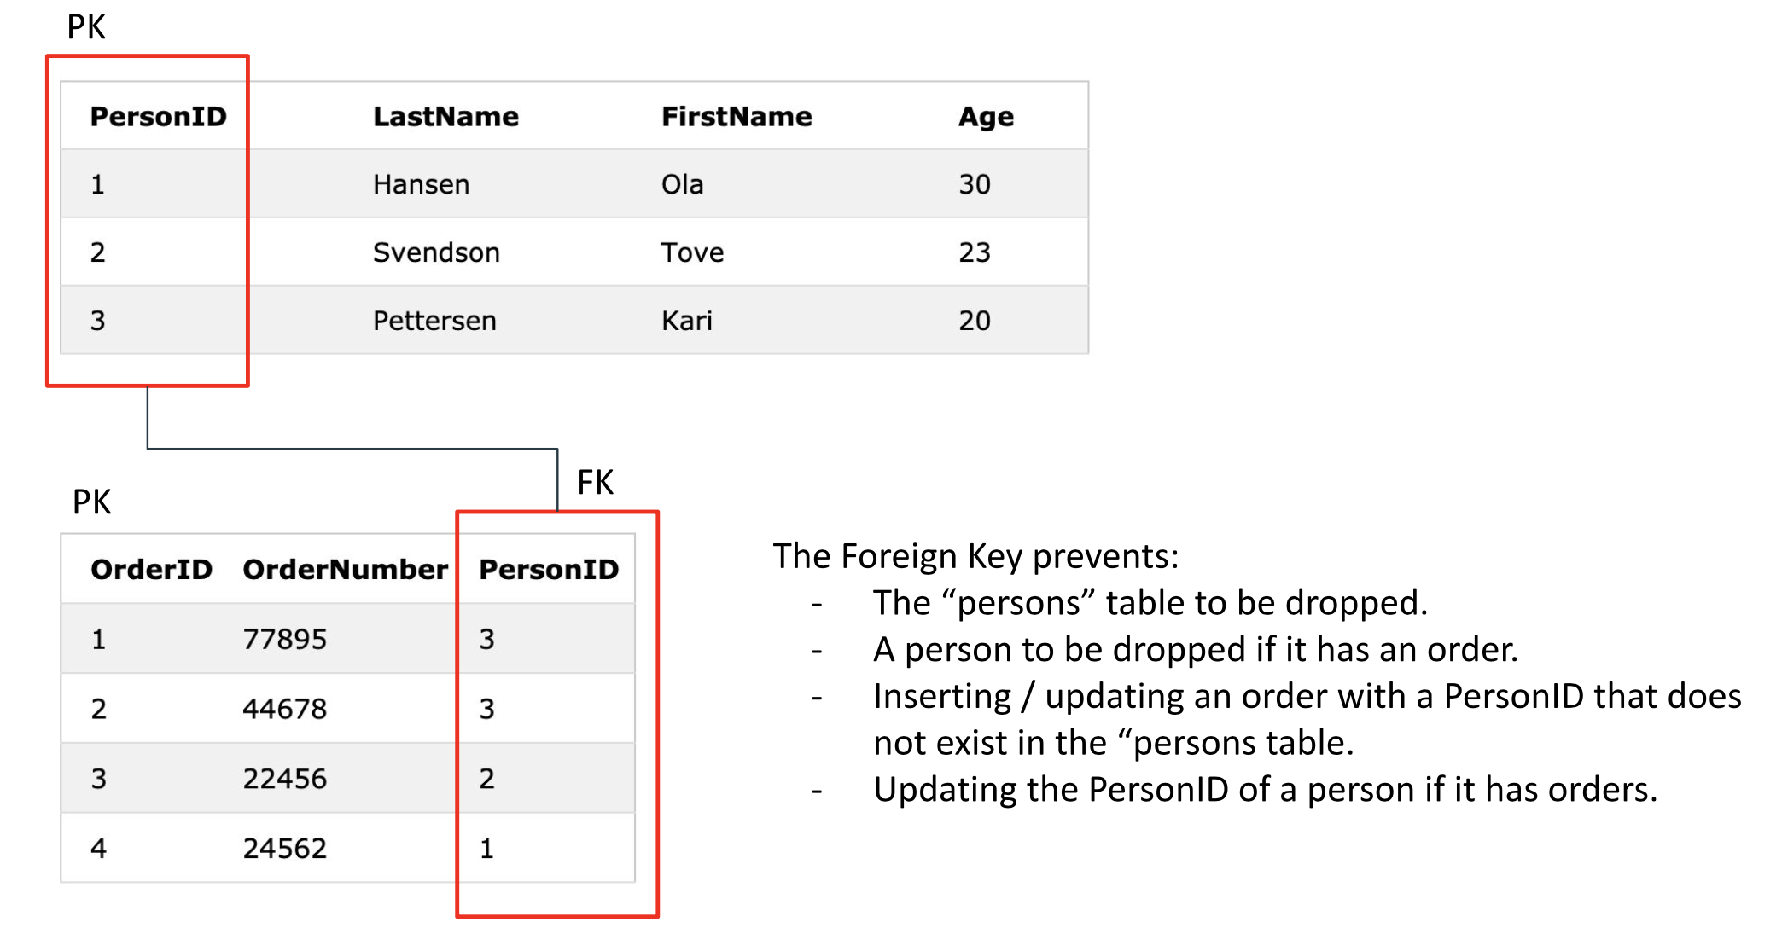
IRONHACK BOOTCAMP
PRIMARY AND FOREIGN KEY EXAMPLE

Slide 10
DML

Slide 11
IRONHACK BOOTCAMP
LOADING DATA INTO A TABLE: INSERT COMMAND
This command is used to insert records in a table.
The syntax is the following:
INSERT INTO db.table values(...., …., …., ….);
The values inside the list should be provided in the same order as the columns.
The value types should match the column types

Slide 12
IRONHACK BOOTCAMP
LOADING DATA INTO A TABLE: LOAD DATA
This command is used to add data from a local file into a table:
LOAD DATA LOCAL INFILE '/path/pet.txt' INTO TABLE pet;
Pay attention to the field separator! By default, the field separator is a tab ‘\t’.

Slide 13
IRONHACK BOOTCAMP
Update Records ( TODO)

Slide 14
IRONHACK BOOTCAMP
DELETE COMMAND
This command is used to delete records in a table.
The syntax is the following:
DELETE FROM db.table WHERE condition;

Slide 15
IRONHACK BOOTCAMP
ADDITIONAL READING
Creating a database
ERD

Slide 16


